Slide 1
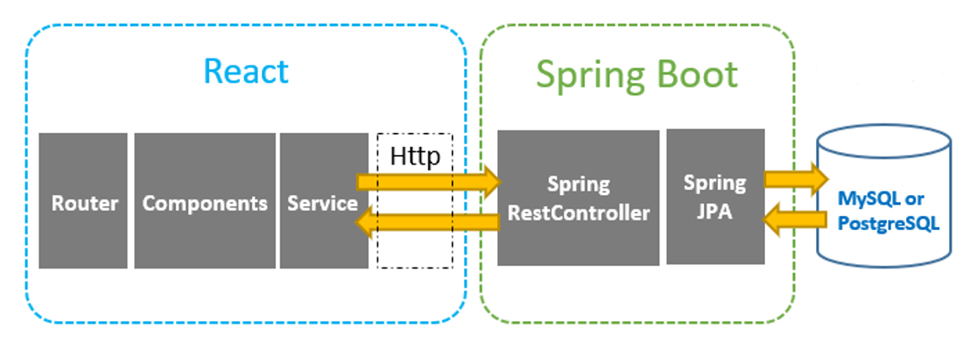
MyHealthy API Layout

Slide 2
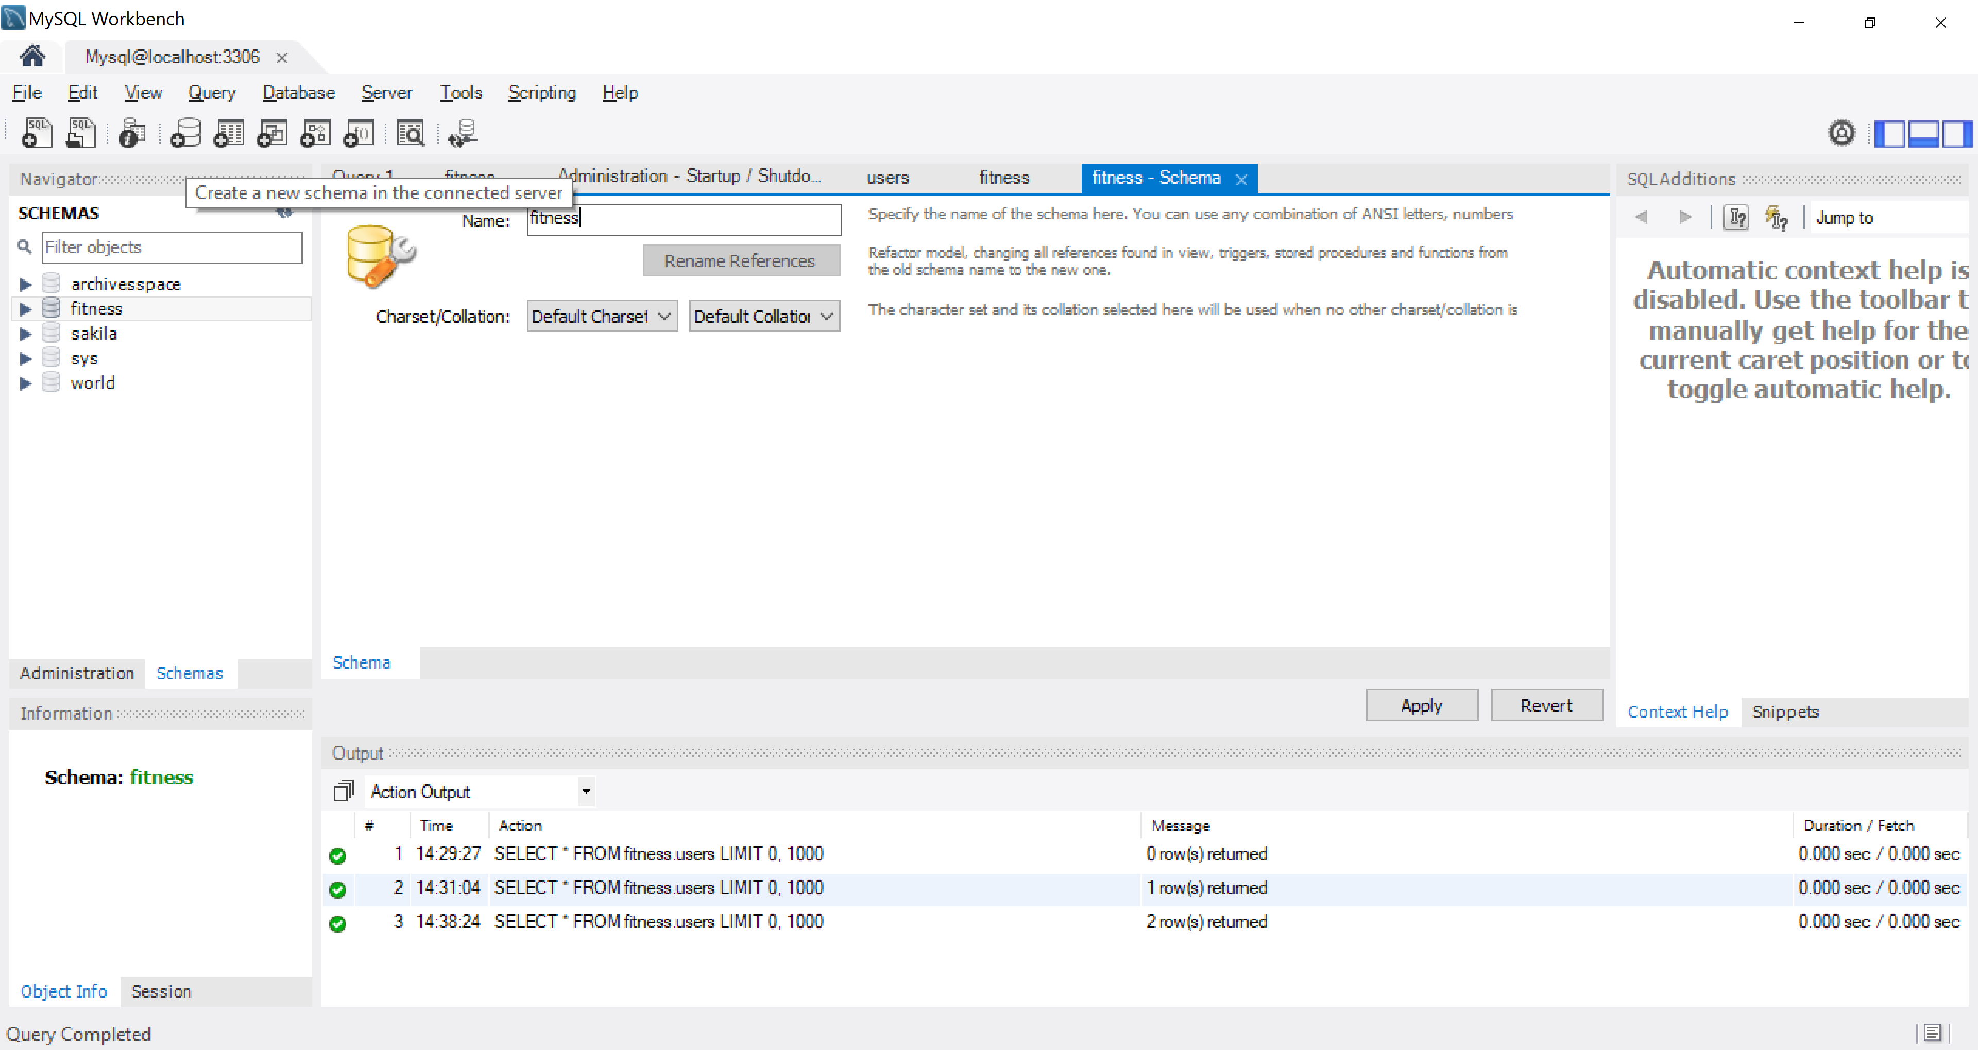
Create the “fitness” database

Slide 3
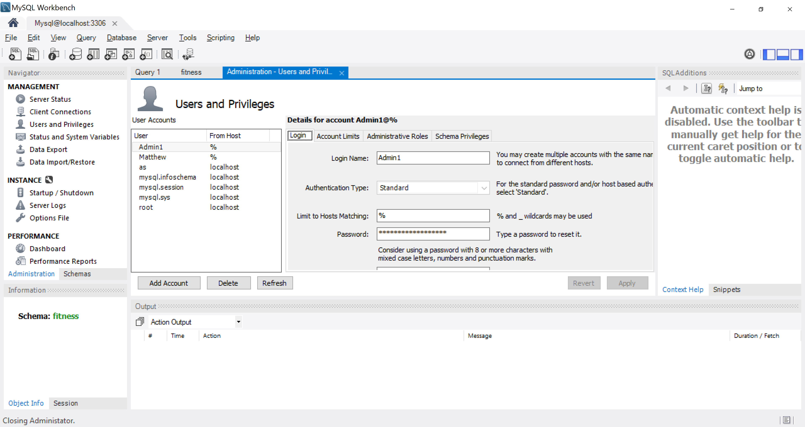
Create an account with username Admin1 and password Admin1PW!

Slide 4
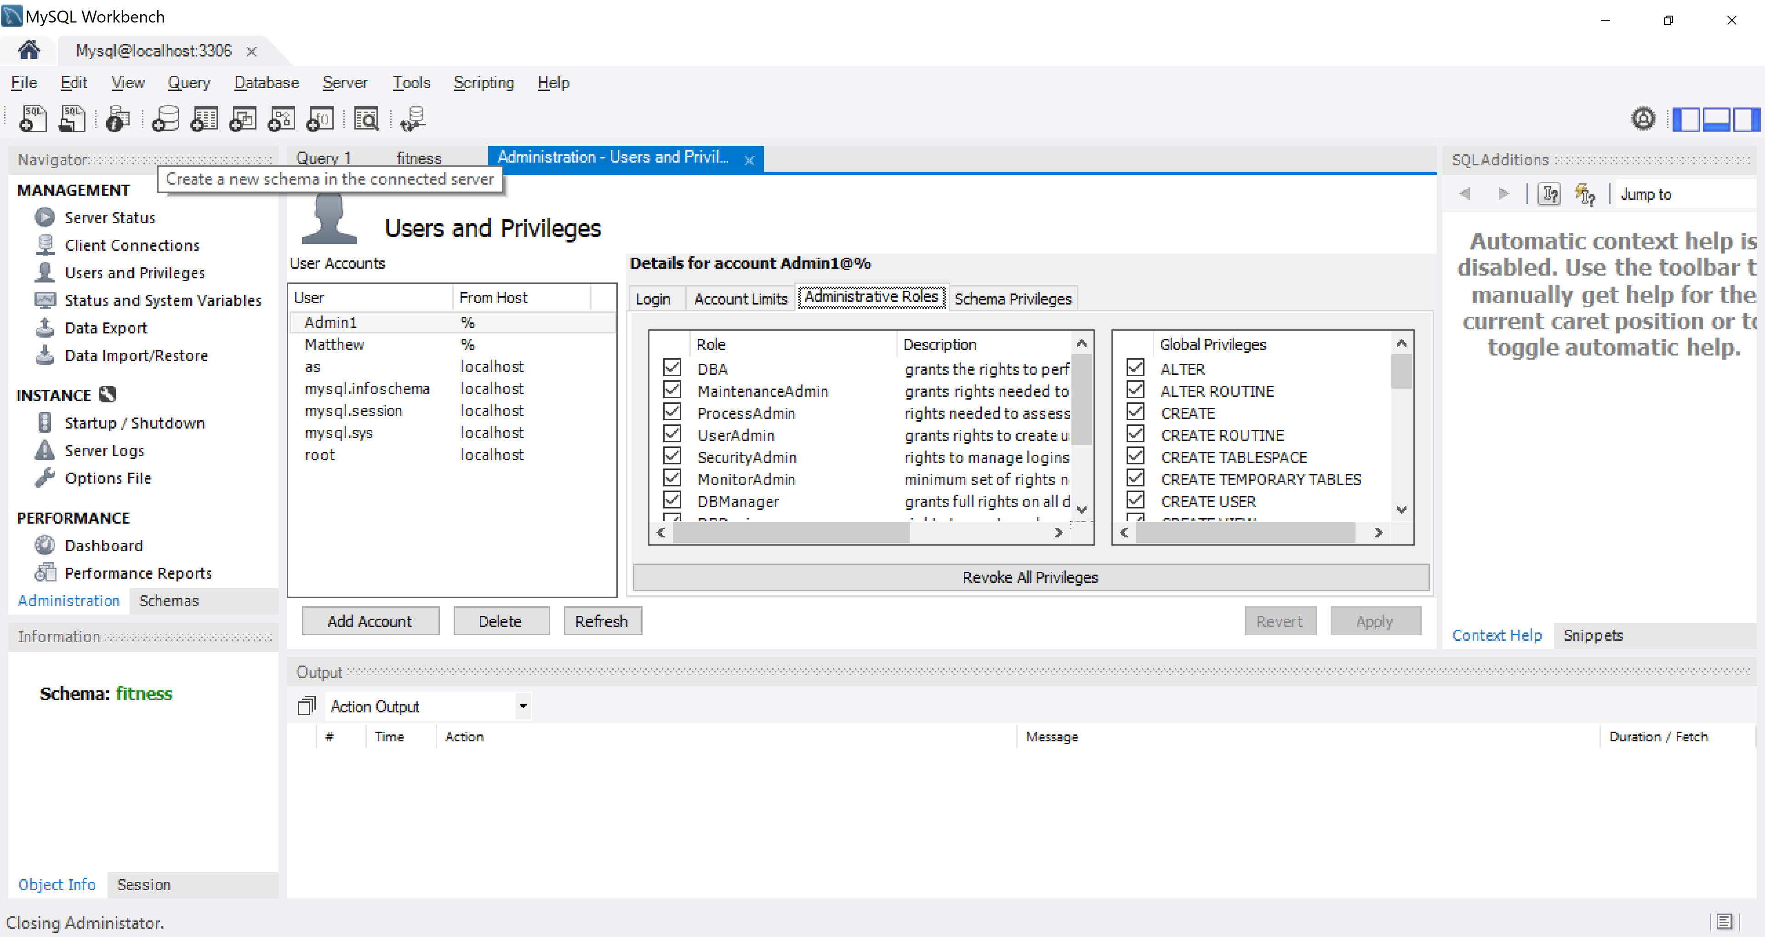
DBA admin rights to the Admin1 user account

Slide 5
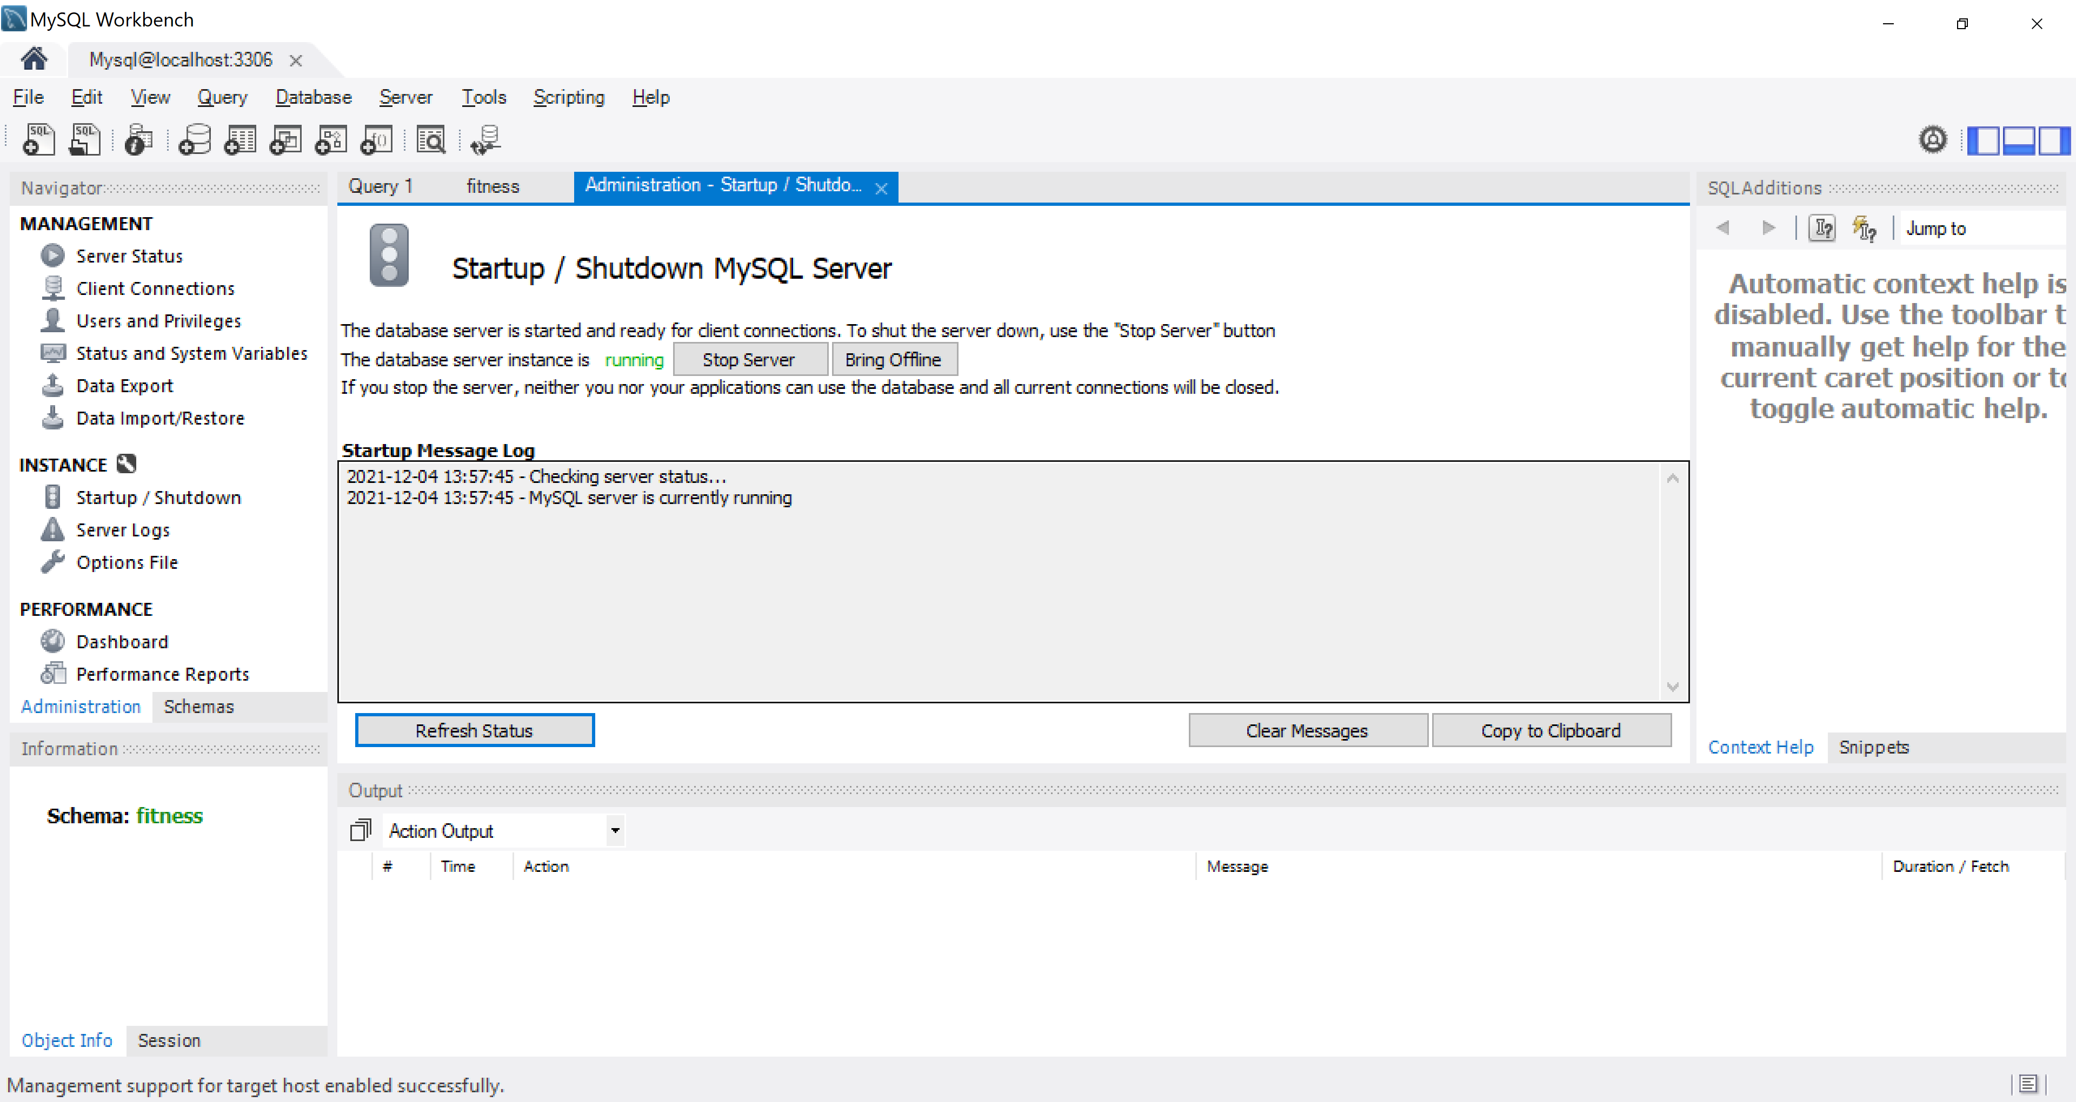
Make sure MySQL Server is running (use the Startup/Shutdown tab)

Slide 6
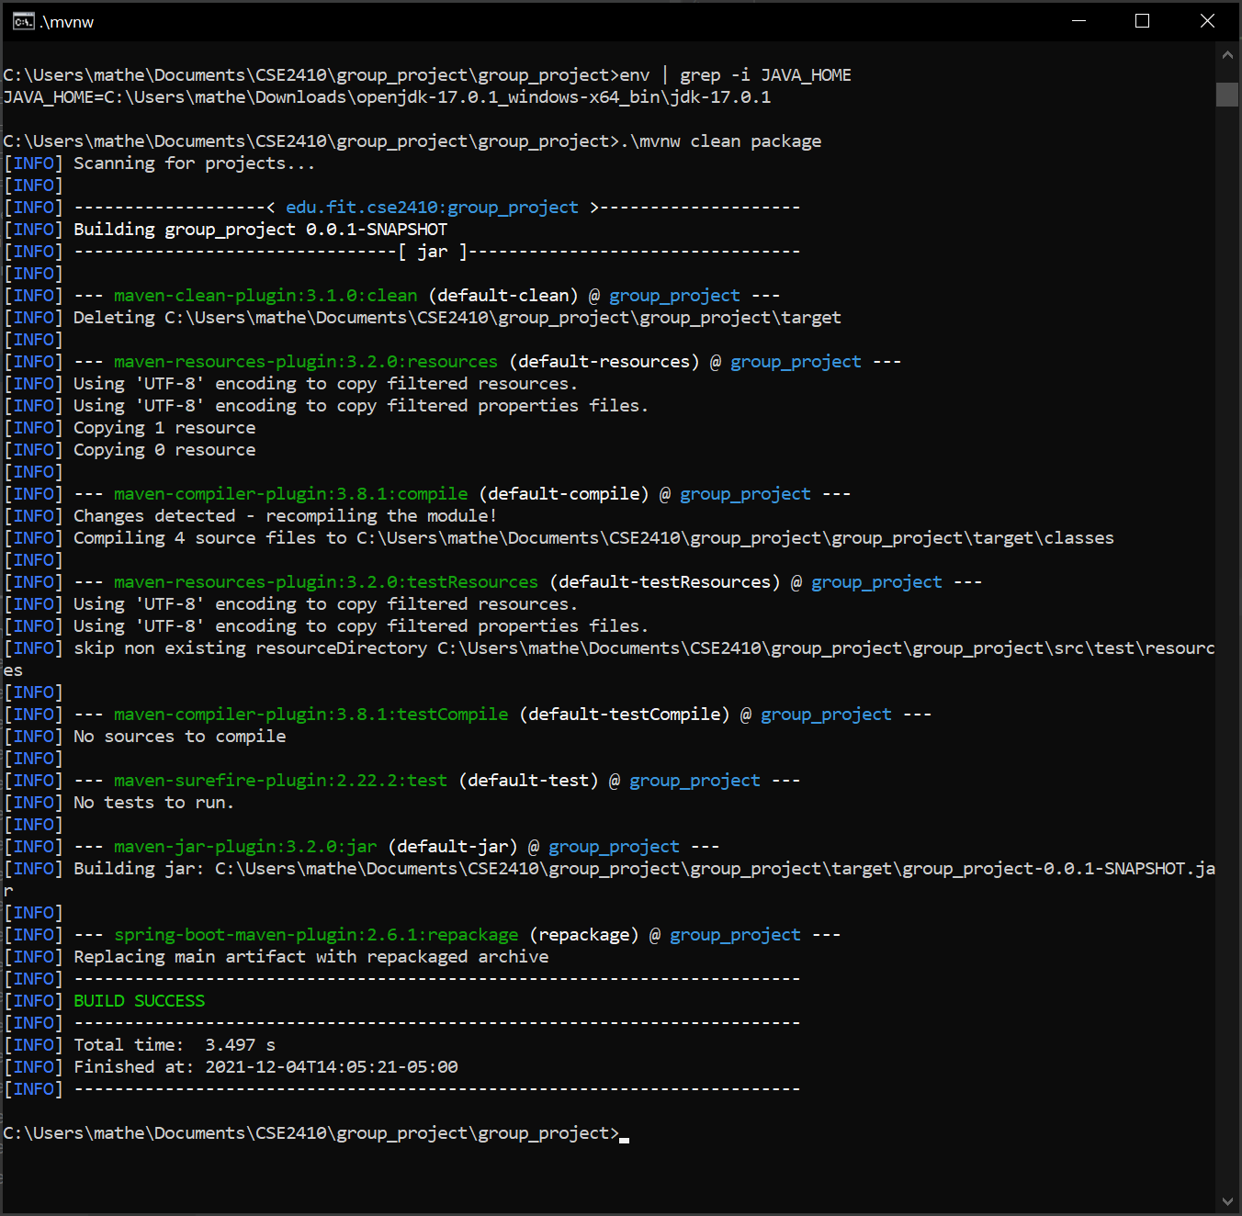
Build with ./mvnw clean package. Make sure JAVA_HOME environment variable is jdk(not jre)

Slide 7
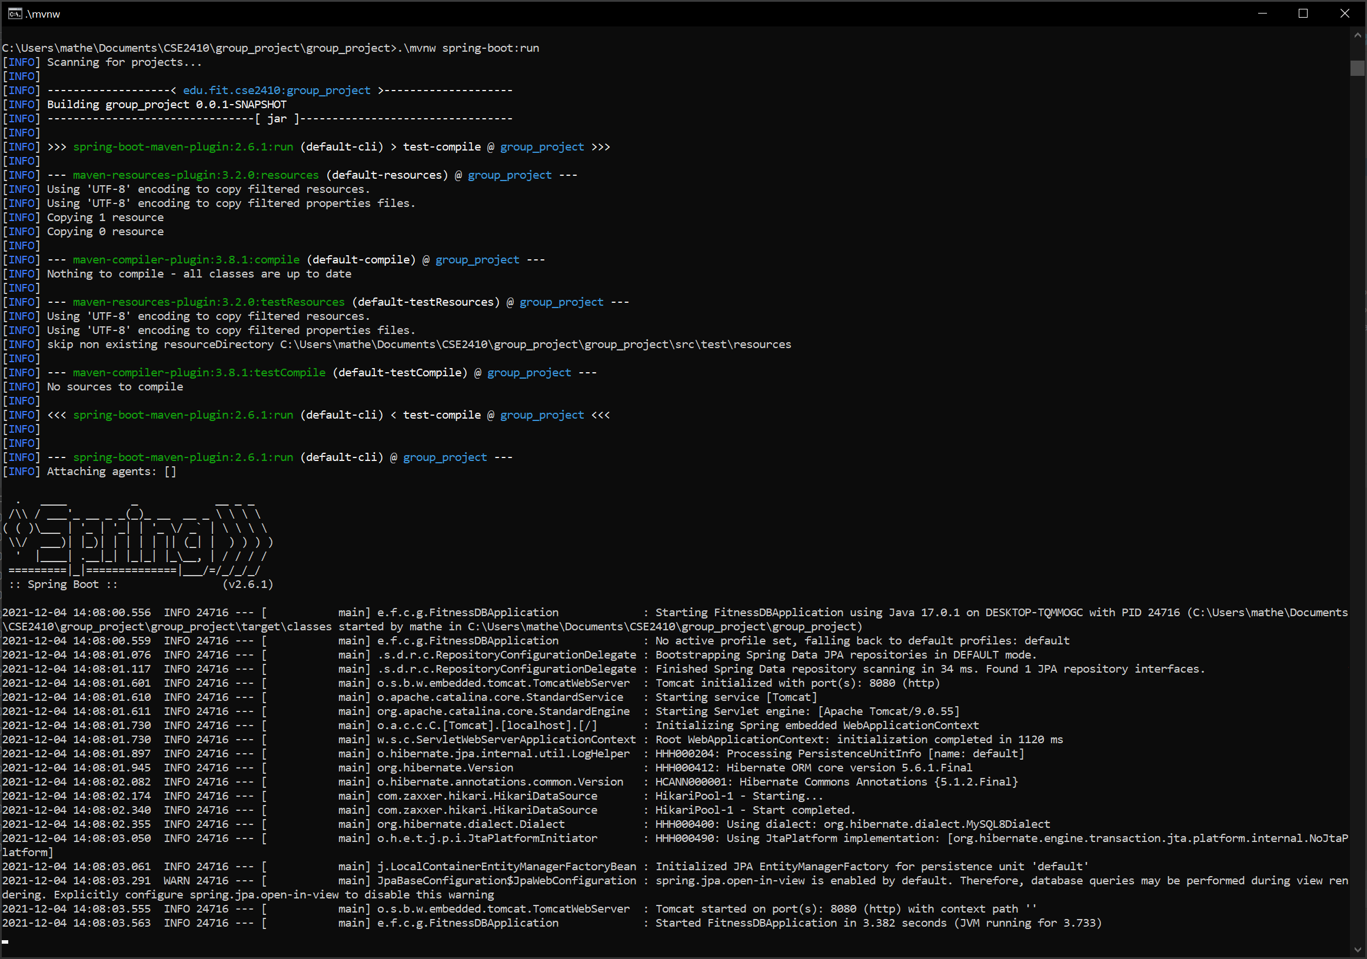
Run Spring service with .\mvnw spring-boot:run

Slide 8
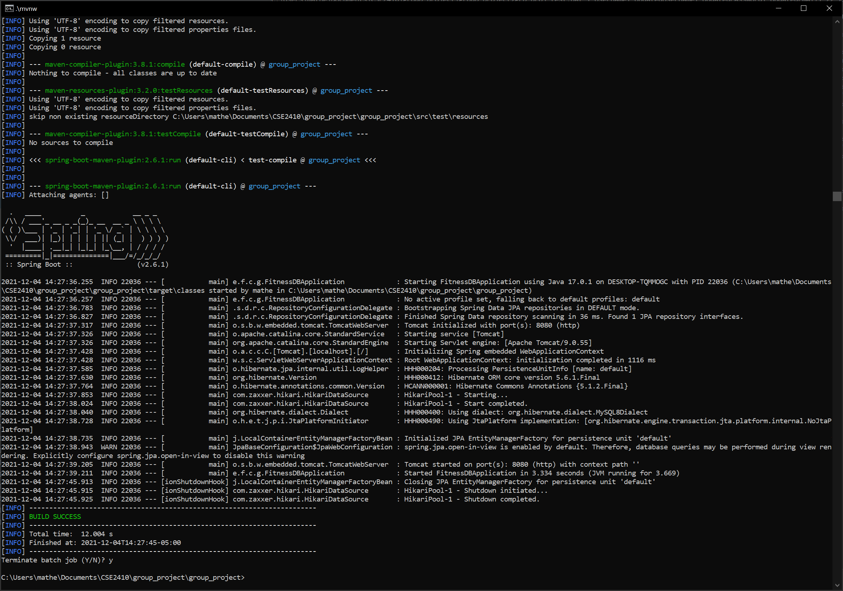
Stop Service with Control C when done

Slide 9
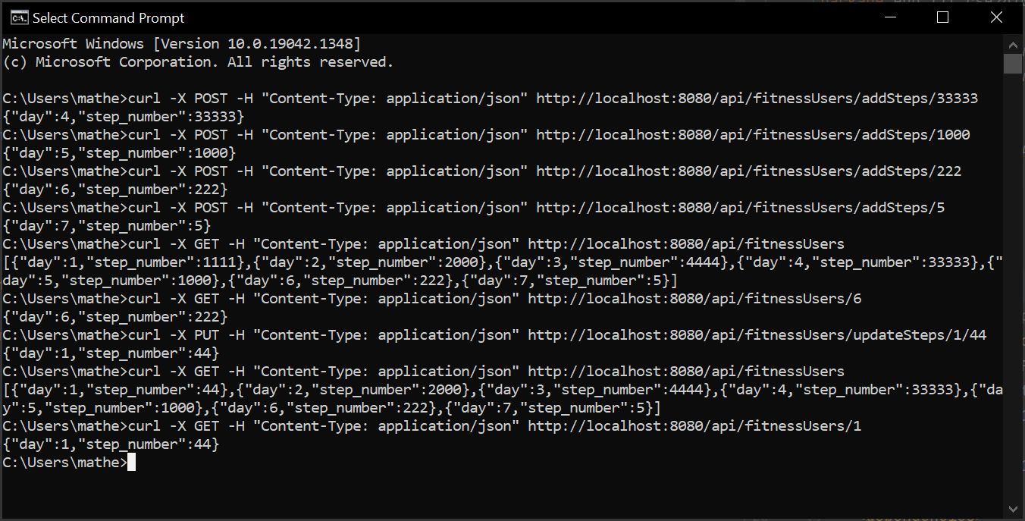
Curl commands to test web services

Slide 10
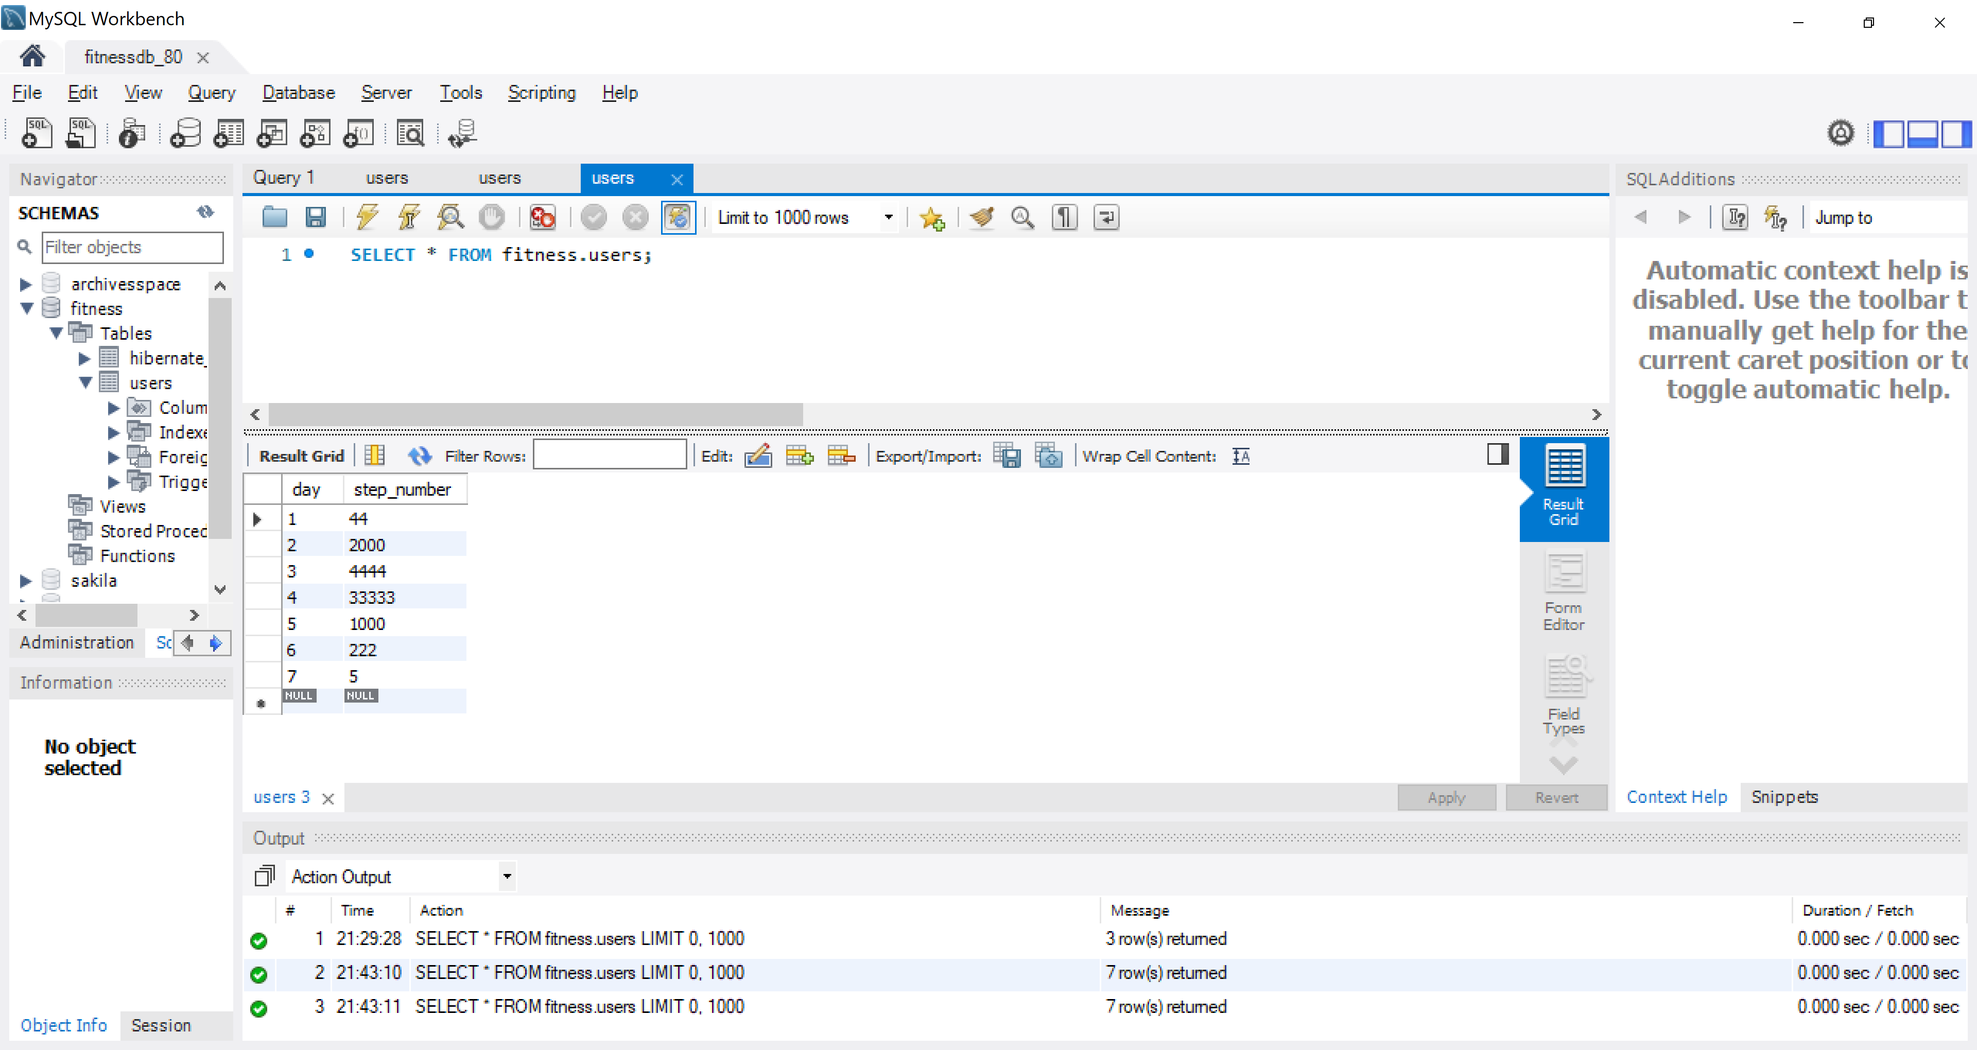
Database in MySQL

Slide 11
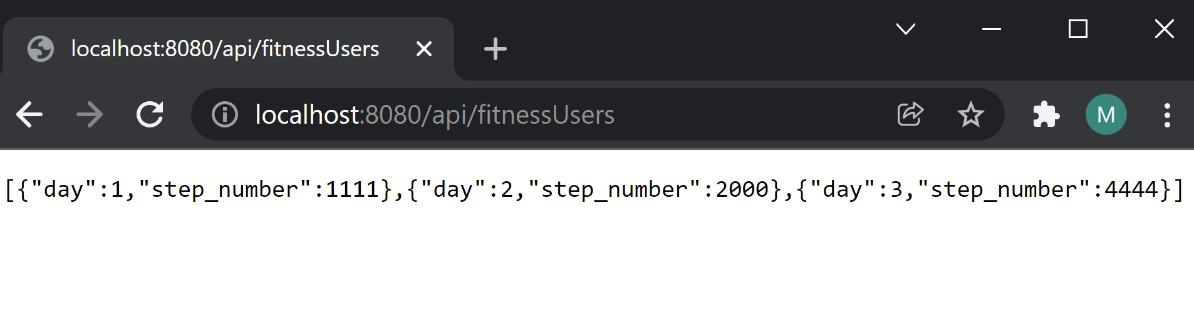
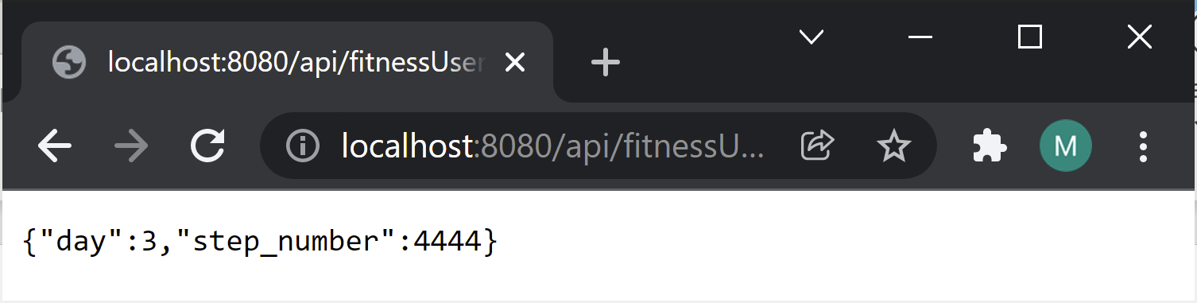
Localhost webservice with database in JSON

Slide 12
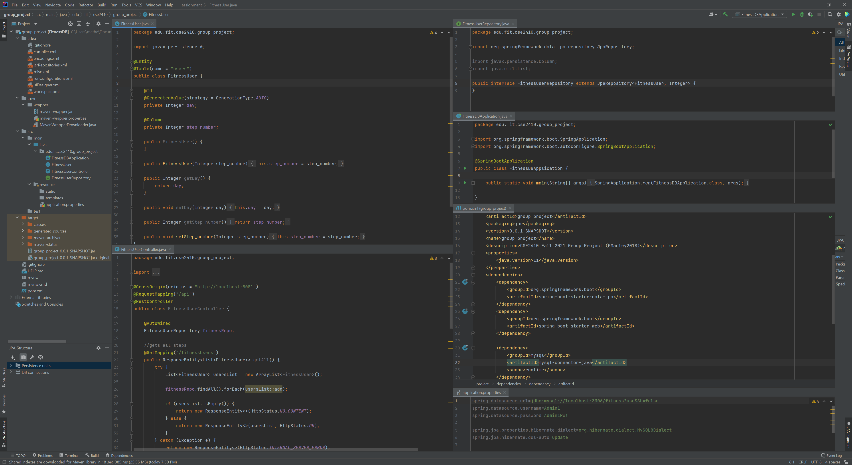
Back-end code on IntelliJ

